Slide 1

Project Name
Hospital Management System
By
MD. Nayab Ansari 12020002026019
Vishal kr. Jaiswal 12020002026020
( B.Tech. 3rd Year AIML )
Under the Supervision of
Prof. Dipt Mukherjee
Dept. of Computer Science & Engineering
University of Engineering & Management, Jaipur

Slide 2
Outlines
Introduction
Literature Review
Objectives
Proposed Model
Experimental Setup
Result Analysis
Conclusion & Future Scope
Reference
Acknowledgement

Slide 3
Introduction
The software is for the automation of Hospital Management System.
It maintains three level of users :- Administrator level
:- Doctor level
:- Patient level
The Software includes :- Maintaining Patient record which include appointment and appointment history .
:- Maintain all the doctor details and their bookings for appointment.
:- It has a administrative page which maintains all the patient and doctor details.

Slide 4
Literature Review
One of the major challenges existing hospital management systems face is around operational efficiency and wait times between different processes, departments and persons. This paper highlights such limitations of existing systems and proposes a RFID(Radio Frequency ID) and wireless sensor based , location and information management framework that facilitates real time tracking of hospital assets, personnel and patients as they move through pre-set procedures as part of daily activities of the hospitals. The system covers the visual simulation and providing ability to analyse the ongoing operations so they can be corrected to achieve increased process efficiency and service levels.

Slide 5
Objectives
Building a responsive website for effectively managing hospital with all its Patient details and doctor details. The project also aim to book appointment of Patient with respective doctor. Effectively solve the complication faced by hospital managing staff .

Slide 6
Proposed Model
Managing Hospital effectively with all its staff and patient details

Slide 7
Experimental Set-up
To run this environment we have to use :
1. vscode.
2. xampp for hosting.
3. web browser.
4. Sql setup.

Slide 8
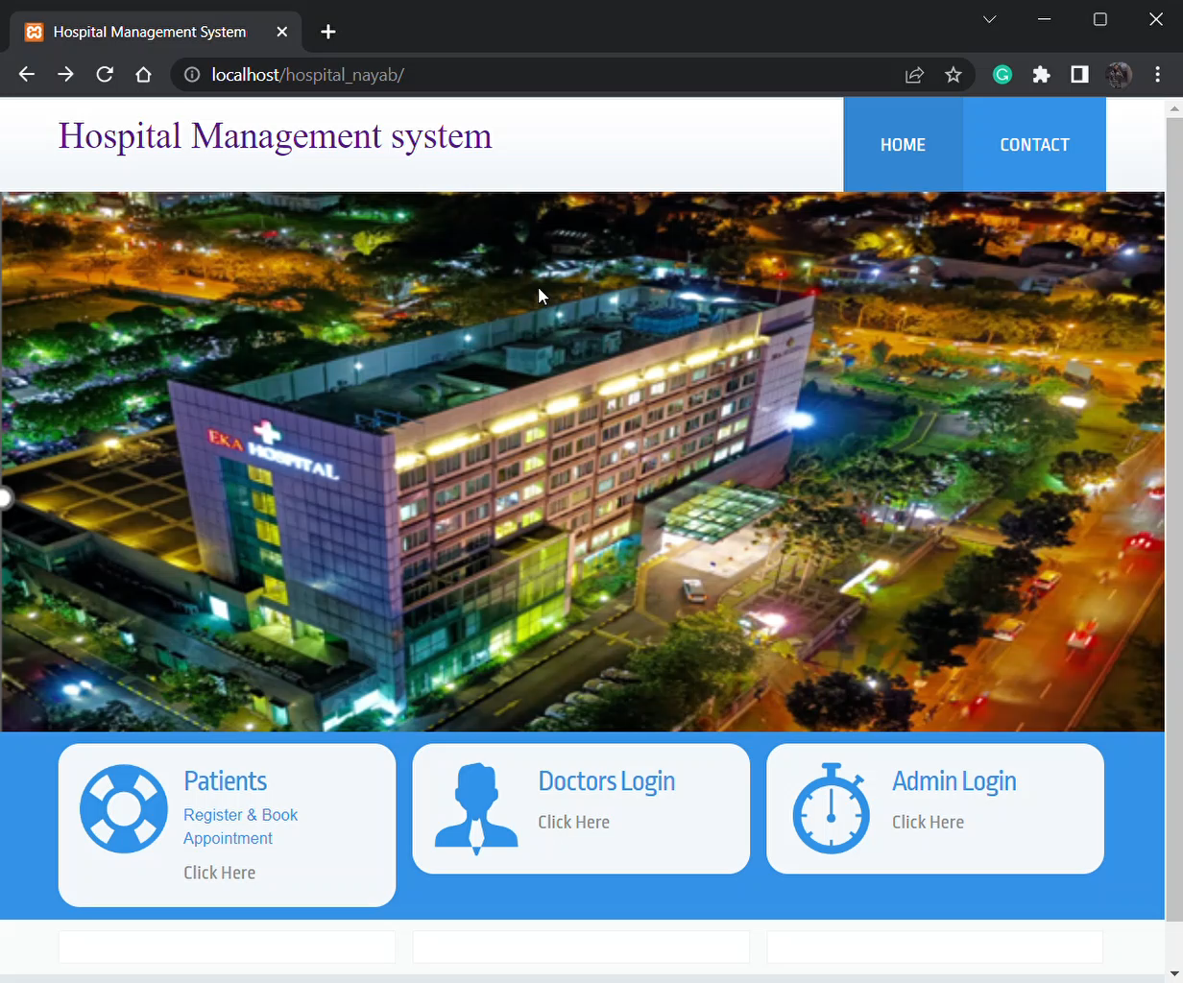
Result: Example

Slide 9
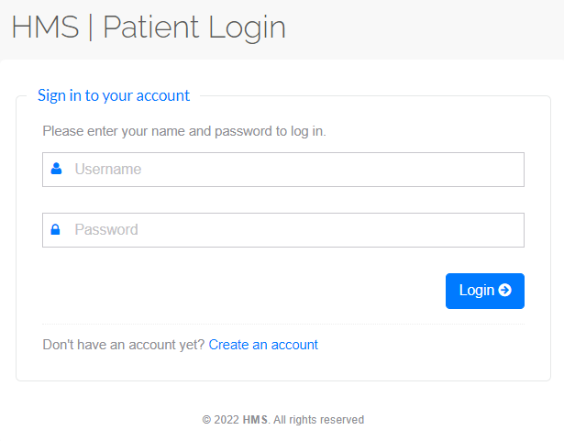
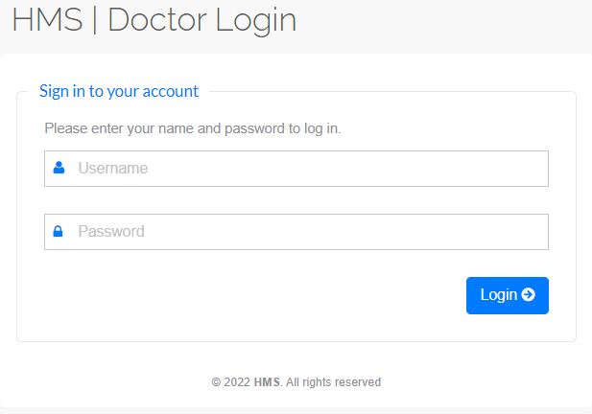
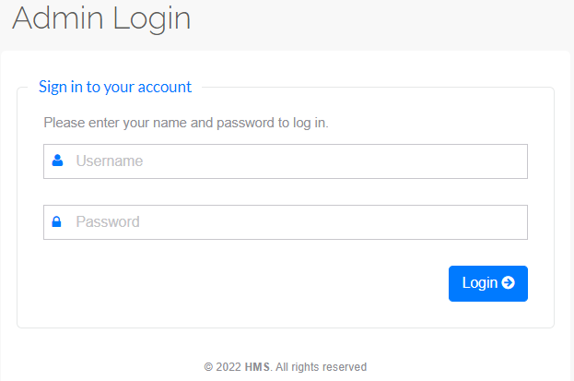
Result Analysis

Slide 10
Limitation
It is a website.
Lack of online payment System.
Lack of chatbot System.

Slide 11
Conclusions & Future Scope
This project is just a website. It is built using PHP ,HTML, CSS ,Java script and other web development application.
The Future of this project includes:
1. Building a app for android and iphone users.
2. Integrating a chatbot system to help old people who cannot type.
3. Integrating a video conferencing system to help people to connect to . doctor online.
4.Online payment system.

Slide 12
References
References are taken from past learning and software building experience.
For errors Stackoverflow and w3school and YouTube helped me.

Slide 13
Acknowledgement
We would like to express my special thanks of gratitude to our mentor as well as our guide Professor Prof. Dipta Mukherje to hand over this auspicious opportunity to work and gain knowledge on this project on the topic of “Hospital Management System” trending in a huge number these days, to help the humanity work faster and more efficiently with this project.
We all are also thankful and grateful to our University of Engineering and Management , Jaipur to have trust on us and for letting us work on such a project with their full support over us always.
We are also thankful to one another in this group to maintain the trust and understanding in ourselves so well to work as a strong team . We didn’t work together as whenever we worked it seemed like playing together and the load got less. We would like to thank all of us together for making this project a success.

Slide 14

Dept. of CSE, University of Engineering & Management Jaipur

